Slide 1
CRIME PREDICTION ANALYSIS
TEAM MEMBERS
Divya A(1817116)
Hafeeza Begum M (1817118)
Keerthana K(1817123)
Pavithra T(1817137)
Project Guide Dr. K.Kumar M.E.,Ph.D., Associate Professor

Slide 2
PROBLEM STATEMENT
Predict the severity of the crime and predict the crime type depends on the past crime dataset in that location and classify the higher rate of crime type happening in that location.
PROPOSED SYSTEM
.
To predict the crime occurrence in the city at specified location with specified time block of the day.
To predict the crimes which are severe or not is done using Binary classification model.
To predict which crime type occur is done using Multi Class
Classification model.
Bi-LSTM Methods to find the Crime type using the given test data.

Slide 3
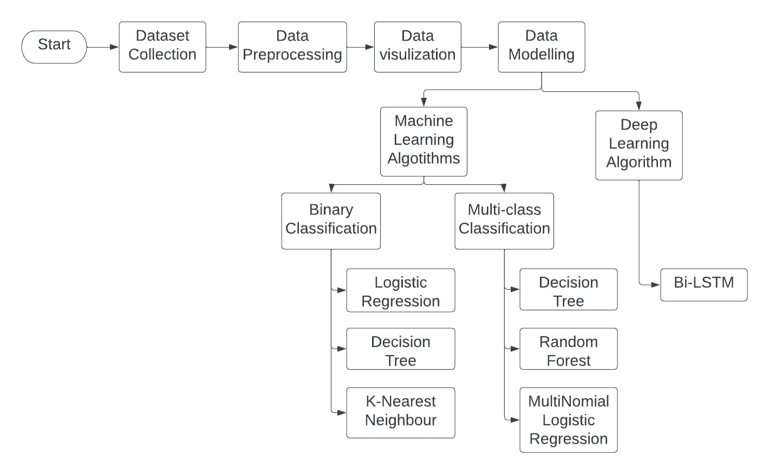
WORK FLOW

Slide 4
Data Collection
The crime dataset obtained from the city of Chicago data portal.
Used the most recent data from year of 2018 to 2022 from the Chicago crime dataset, instead of using the whole dataset which contains more than 8million records back to year 2001.
Chose not to use earlier data because the distribution of crimes can change over time due to various reasons and the most recent 4 to 5 years will be more relevant to the current situation since problem as a classification problem instead of a time-series problem.

Slide 5
Data Preprocessing
Step 1: Excluded records with vague information
Step 2: Removed extremely rare crime types and locations
Step 3: Converted categorical features to dummy (indicator) variables for classification
Step 4: Extracted the time information and converted categorical features to dummy variables
Step 5: Added an extra feature "distance to closest police station"
Step 6: Integrated socioeconomic status of the neighborhood where the crime happened

Slide 6
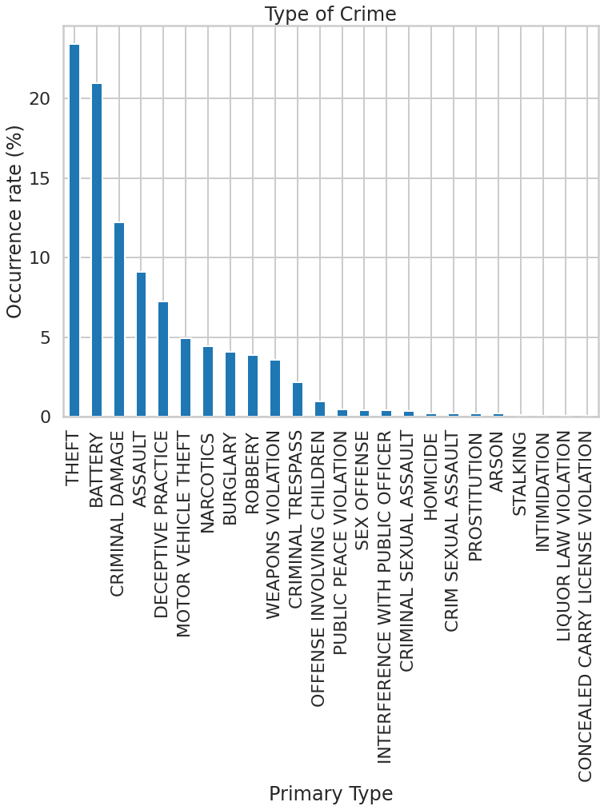
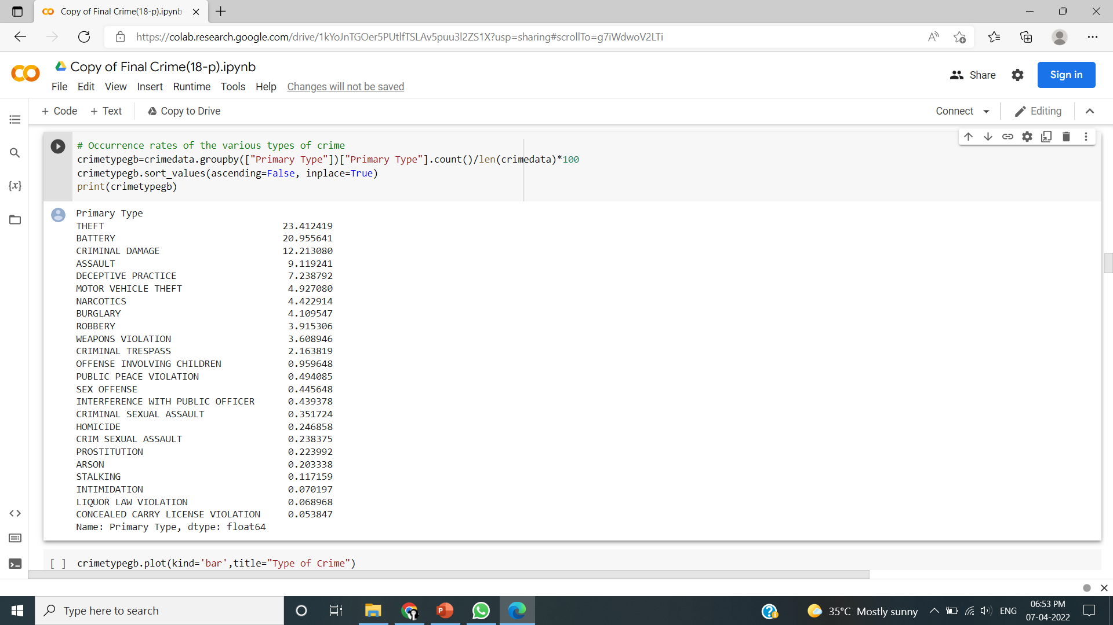
Data Visualization
Types of crime

Slide 7
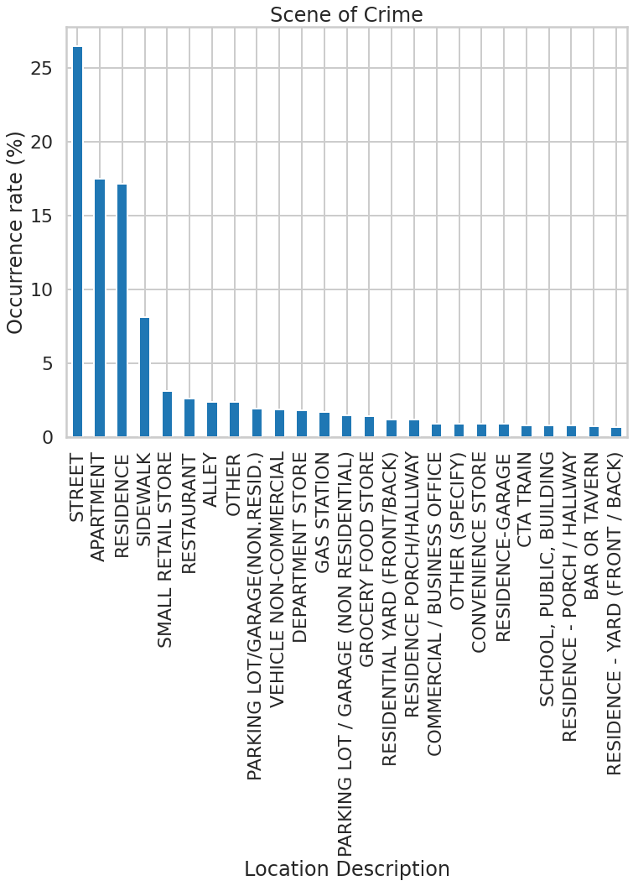

Crime Rate in Location

Slide 8
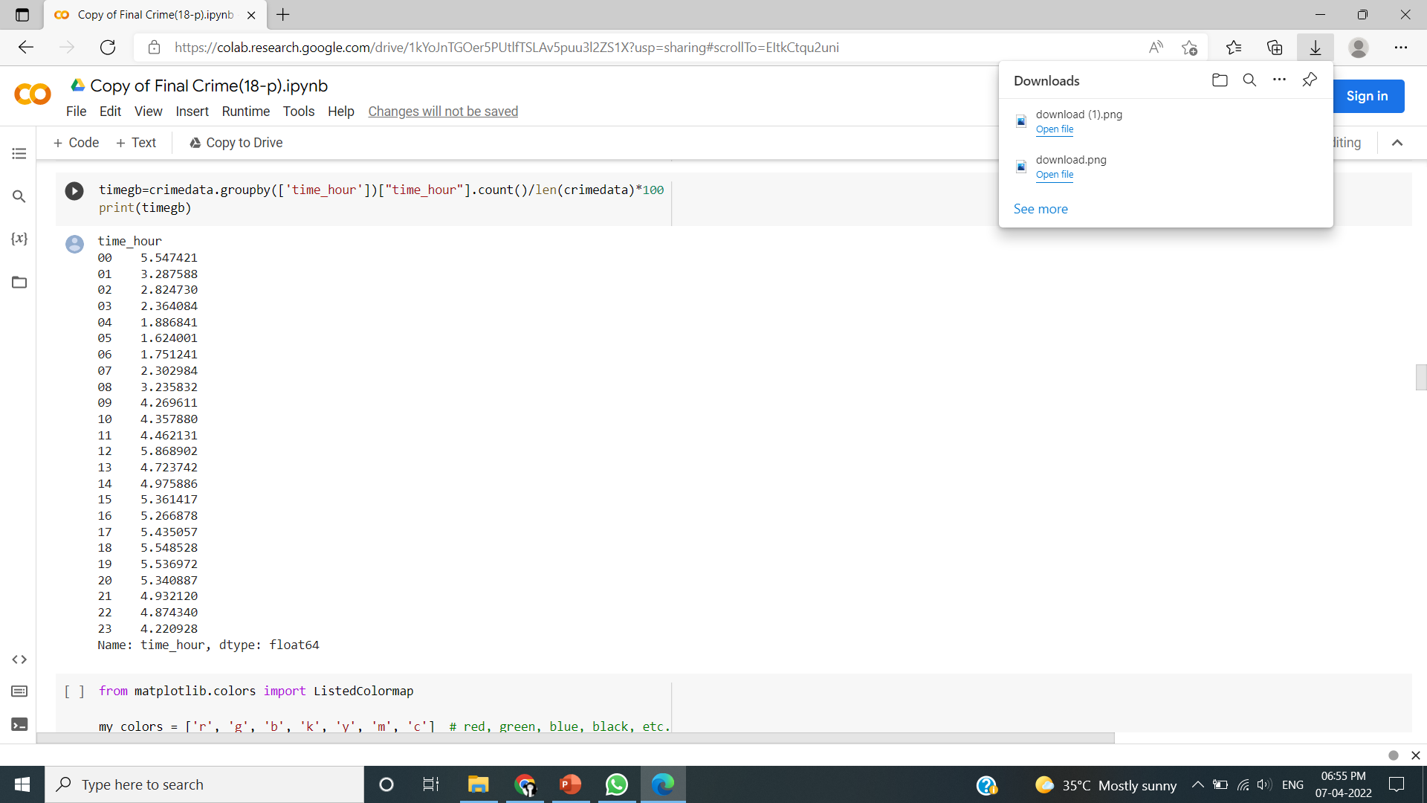
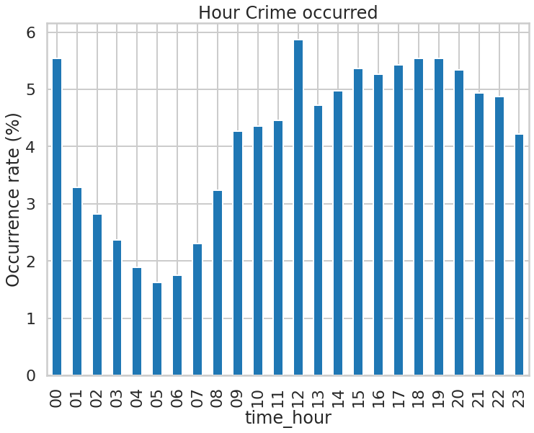
Crime Rate on Hourly basis

Slide 9
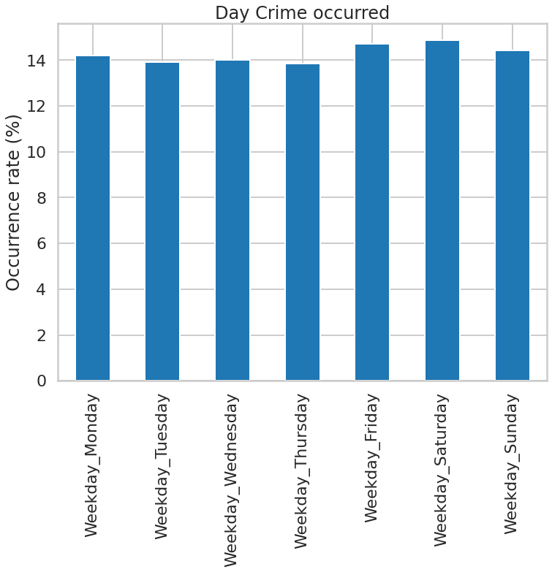
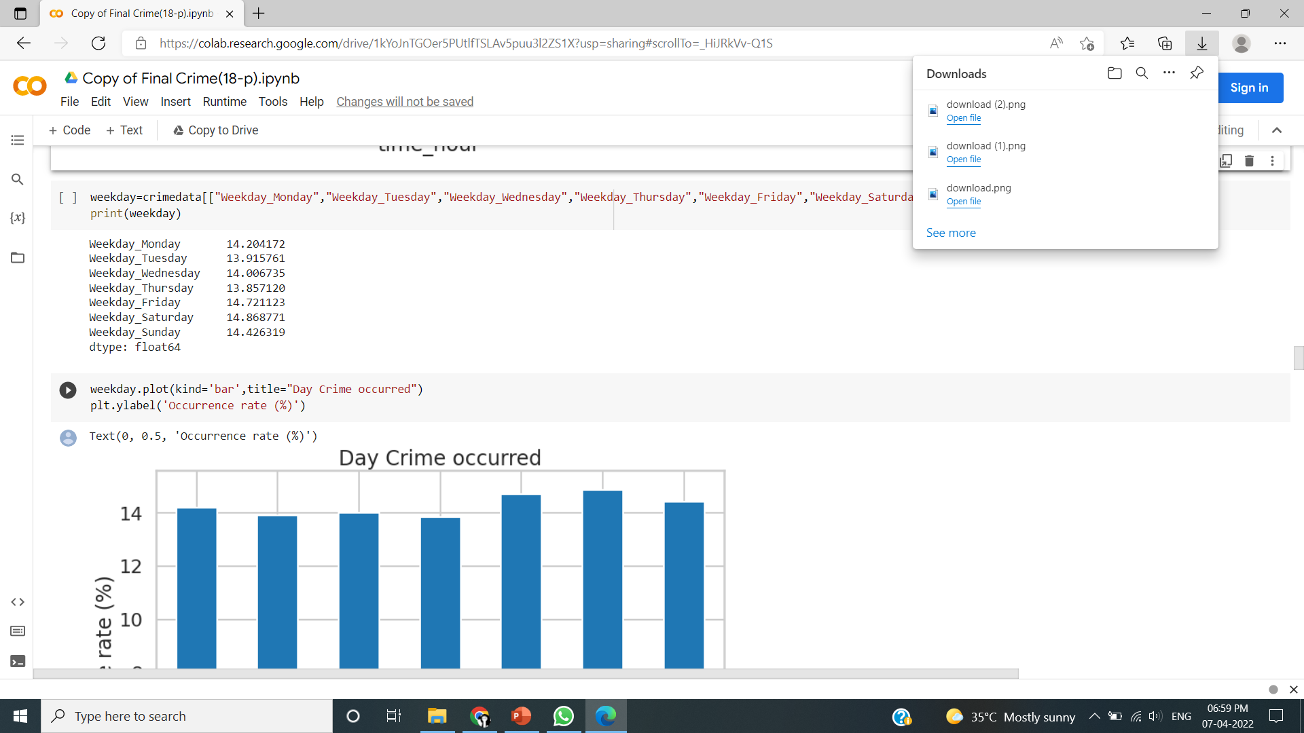
Crime Rate on Daily basis

Slide 10
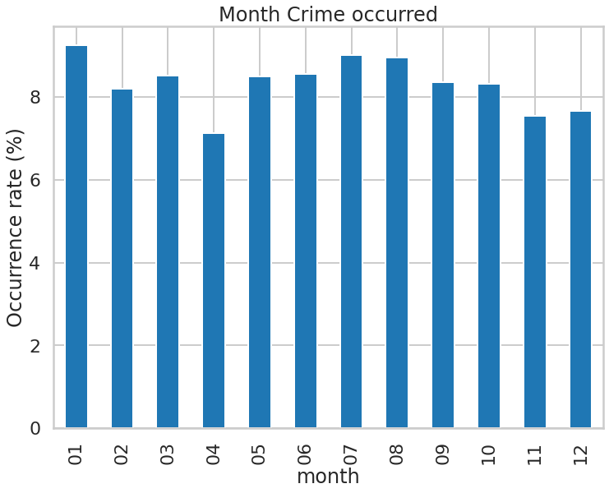
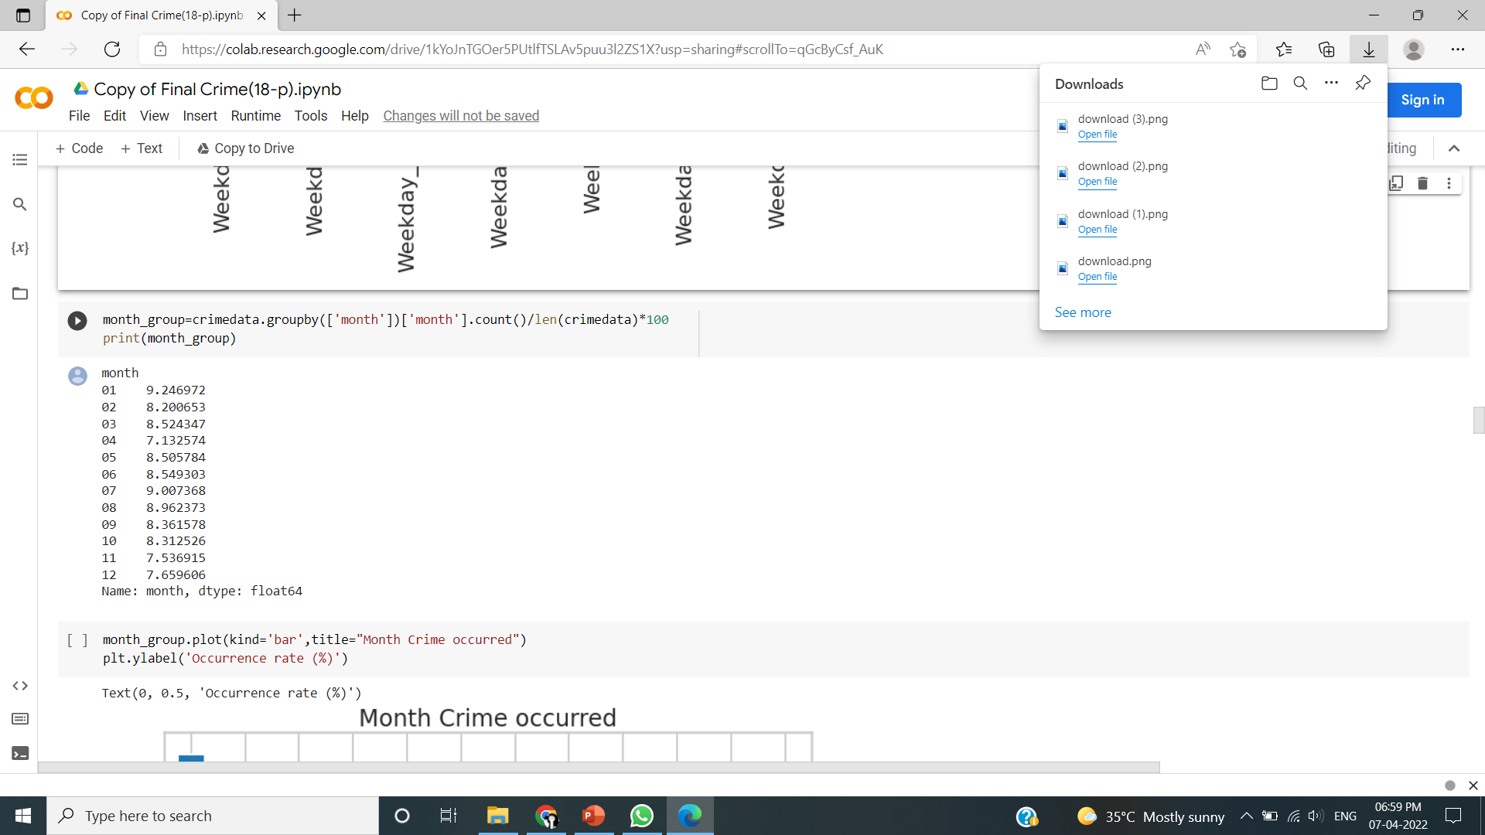
Crime Rate on Monthly basis

Slide 11
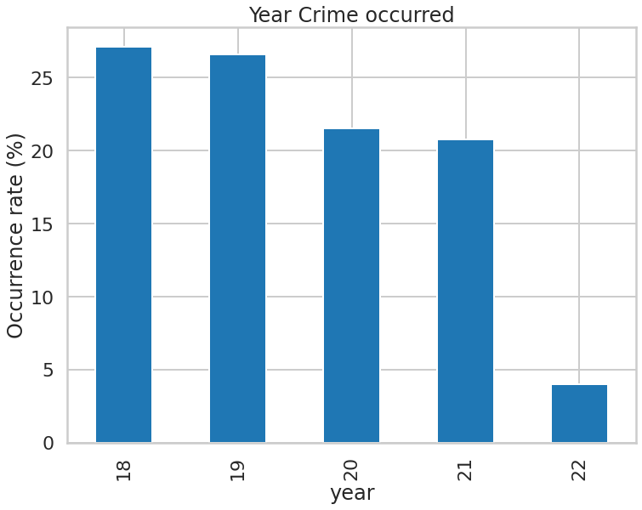
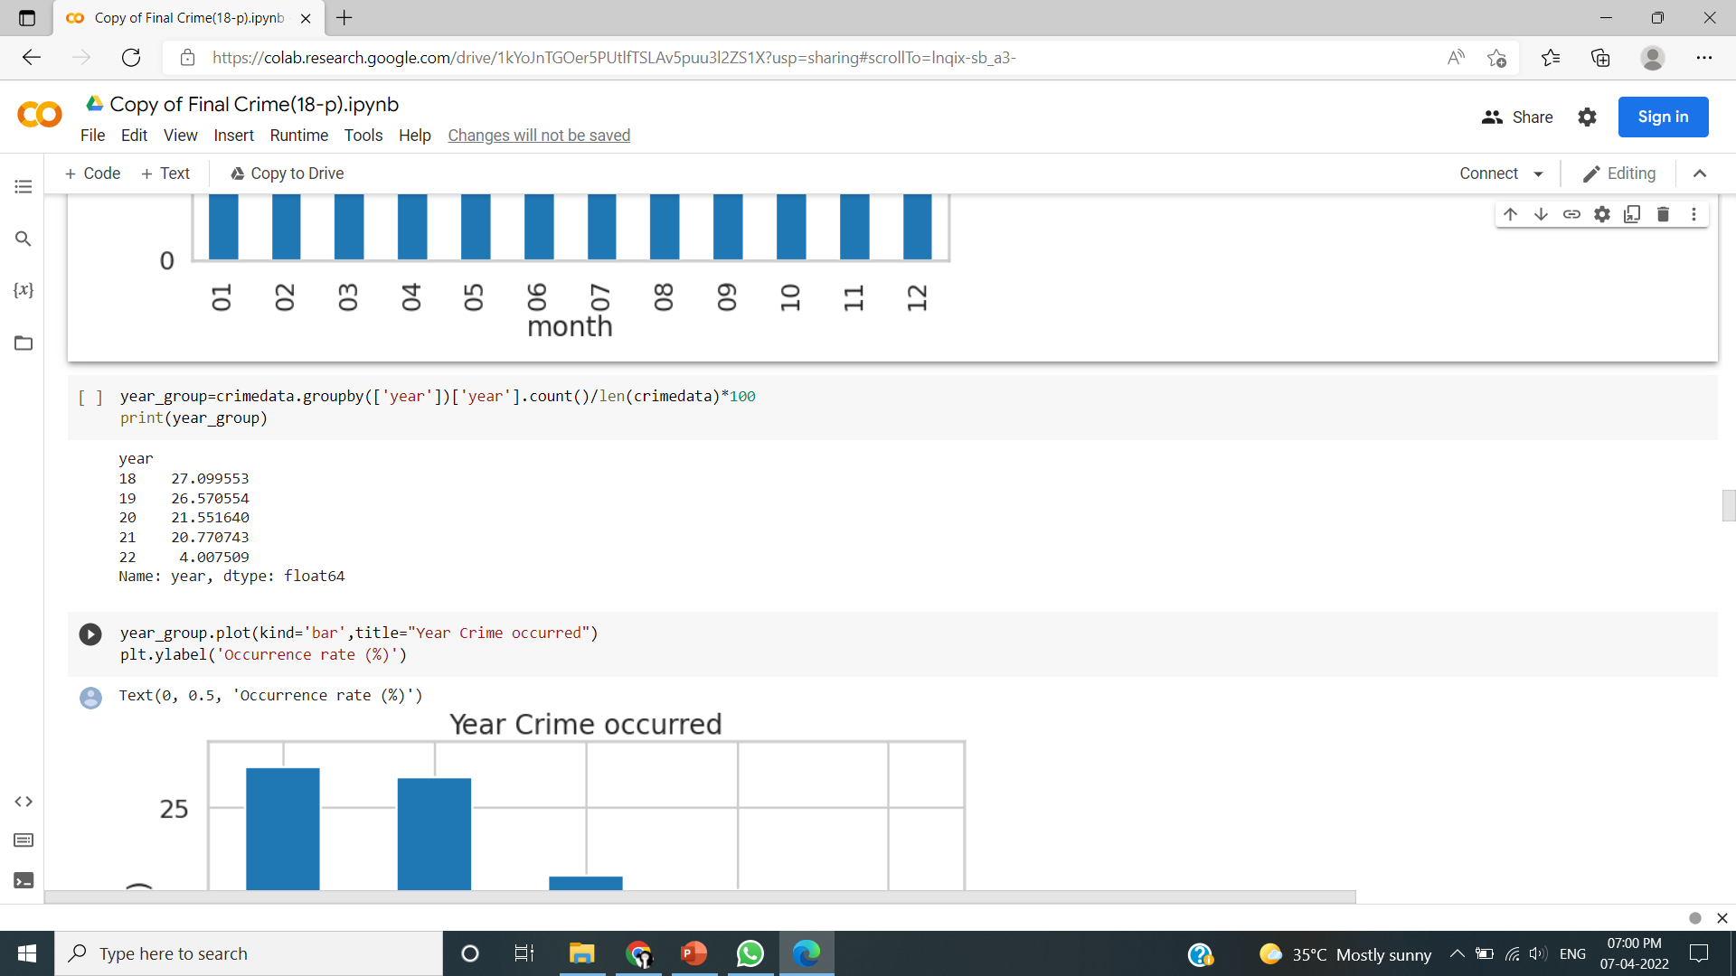
Crime Rate on Yearly basis

Slide 12
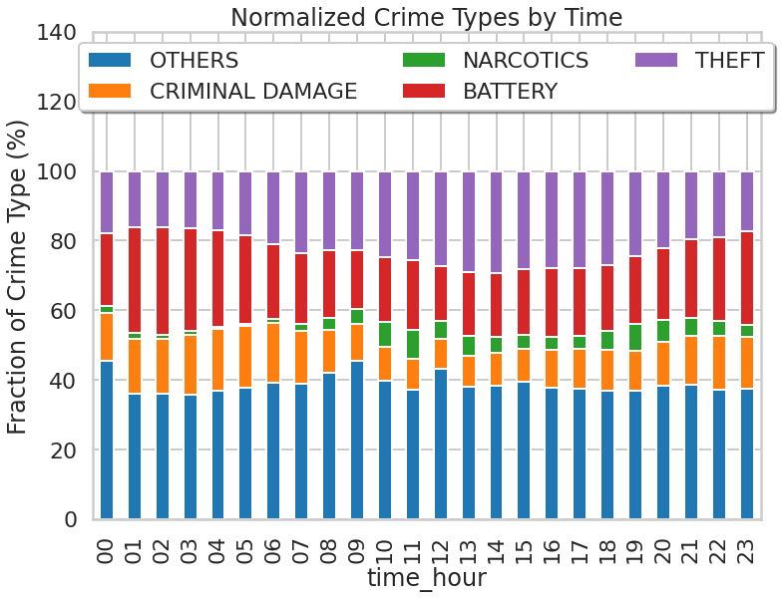
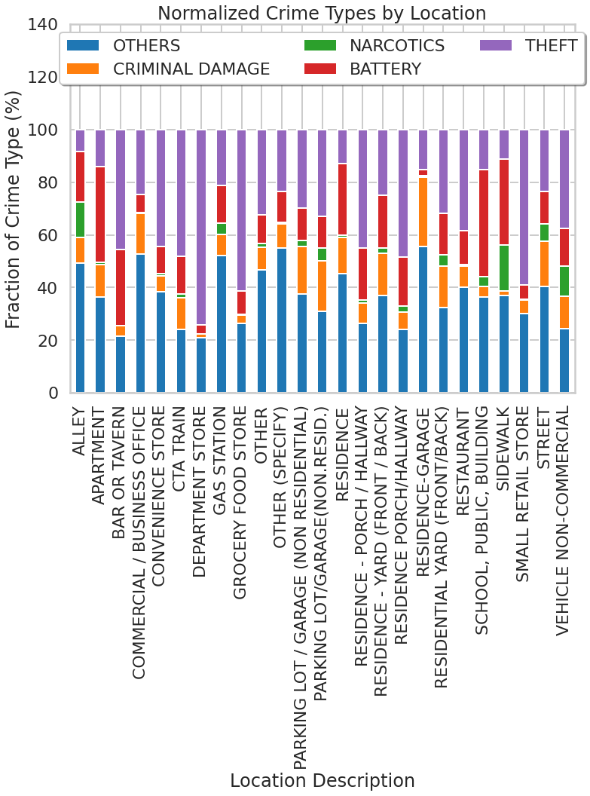
Variantion of Crime in Location
Variantion of Crime in Hour

Slide 13
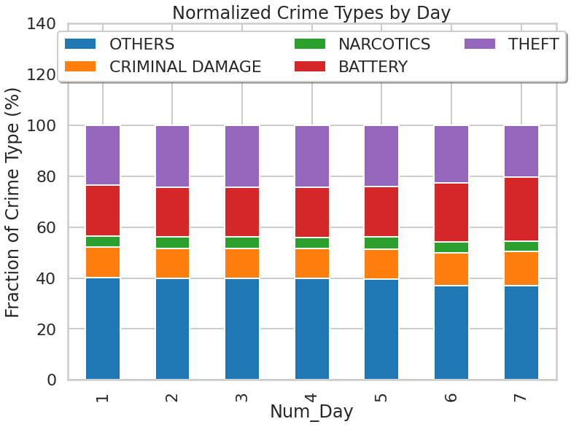
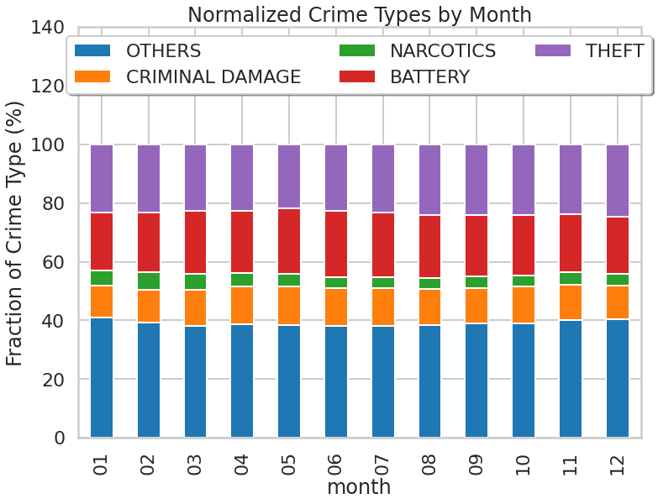
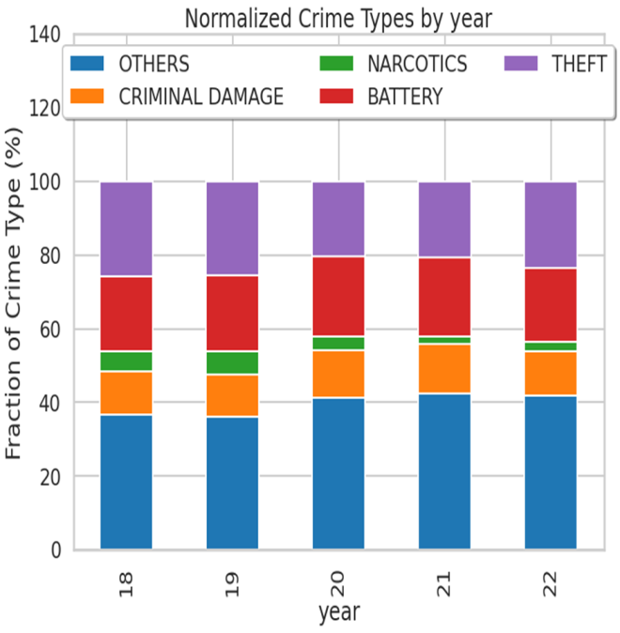
Variantion of Crime in a Day
Variantion of Crime in a Month
Variantion of Crime in a Year

Slide 14
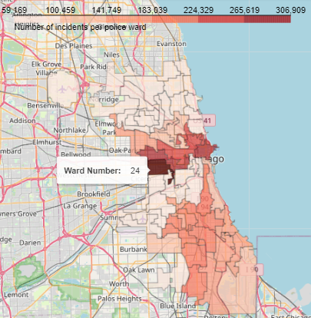
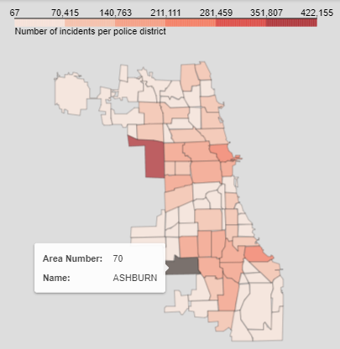
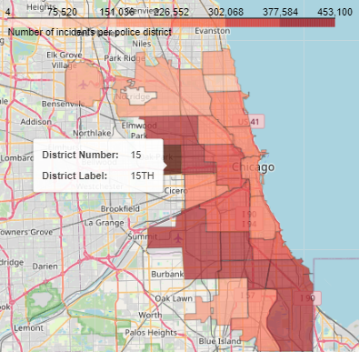
Ward Wise Crime Intensity
Community Area Wise Crime Intensity
District Wise Crime Intensity

Slide 15
Data Modeling
In data modeling tried to build two types of model, Binary Classification Model for predicting whether a crime is severe or not, Multi-Class Classification Model to determine the exact type of crime.
Binary classification model
To predict severity of the crime we use binary classification.
Perform spliting on the 80000 sample records into training set and test set , normalized by themselves.
Latitude and longitude info may be helpful for classification. if the latitude and longitude is low, it’s more likely that severe crime will happen .This is consistent with the fact that the safety at south Chicago is notoriously bad.

Slide 16
LOGISTIC REGRESSION CLASSIFIER
Binary logistic regression (LR) is a regression model where the target variable is binary ,that is it can take only two values, 0 or 1.
The ‘liblinear’ solver supports both L1 and L2 regularization, with a dual formulation only for the L2 penalty.
C is a parameter passed for Inverse of regularization strength, must be a positive float, smaller values specify stronger regularization.

Slide 17
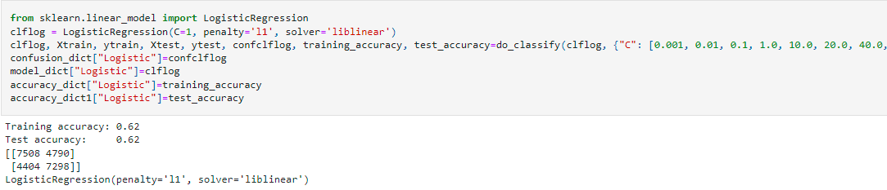
Training Accuracy | Testing Accuracy
62% | 62%

Slide 18
DECISION TREE CLASSIFIER
A Binary Decision Tree is a structure based on a sequential decision process.
Starting from the root, an input is evaluated and one of the two branches is selected.
Case number?
Yes
No
Severe
Non Severe

Slide 19
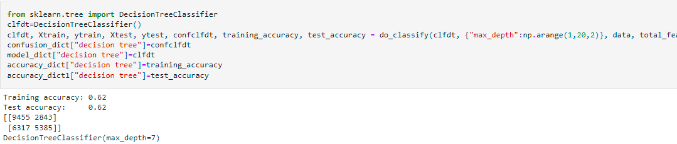
Training Accuracy | Testing Accuracy
62% | 62%

Slide 20
K-NEAREST NEIGHBOR
It classifies a sample based on the category of its nearest neighbor.
The data for KNN algorithm consist of several multi variate attributes name that will be used to classify the data.
It uses two different distances-weighting functions.
The first function is uniform, all points in each
neighborhood are weighted equally.
The second function is inverse, weight points by the
inverse of their distance.
Closer neighbors of a query point will have a greater influence
than neighbors which are further away.

Slide 21
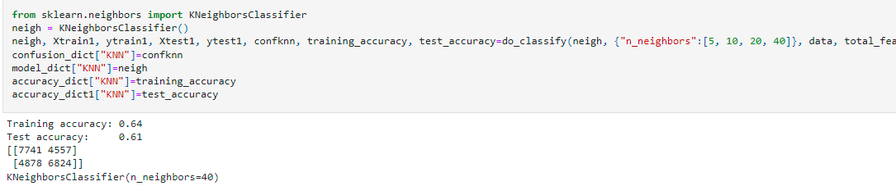
Training Accuracy | Testing Accuracy
64% | 61%

Slide 22
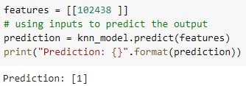
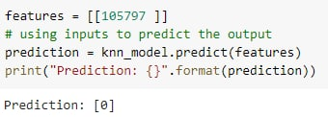
Prediction Of Binary Classification
Severe prediction
Non Severe prediction

Slide 23
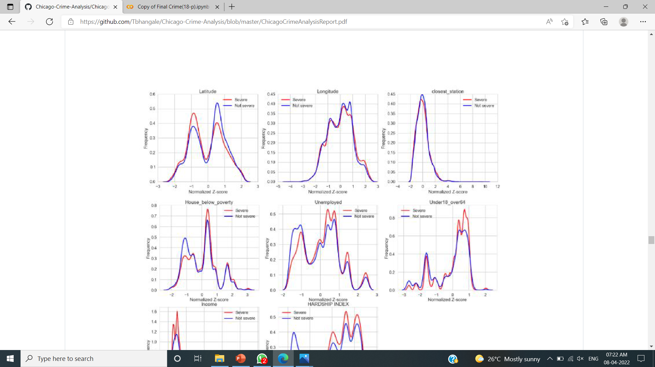
Binary classification model

Slide 24
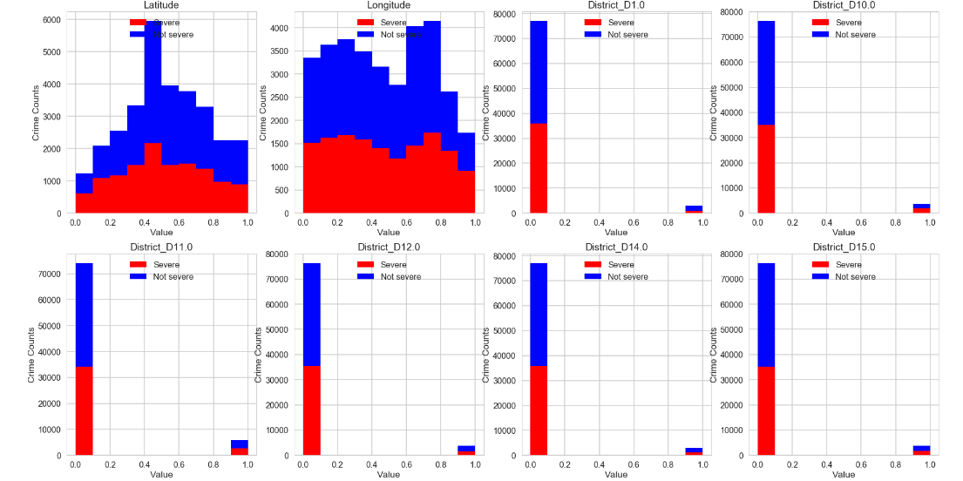
Binary classification model

Slide 25
Multiclass classification
The goal of multi class classification is to classify each record into specific type of crimes.
The first step is to clean up the data as the response variable
specifically needs to be transformed into numpy array.
Another very important thing is that have 25 classes of crimes, but the computational resource does not allow us to do multiclass classification at this scale.
Therefore, here only picked up top four types of crimes. They are THEFT, BATTERY,CRIMINAL DAMAGE, NARCOTICS.
Splitting the data into training and testing sets.

Slide 26
Decision Tree
Decision tree is a non parametric supervised machine learning method .
Predicts the value of a target variable by learning simple decision rules
Inferred from the data features. In order to build Decision tree CART
Algorithm is used which stands for classification and regression tree
algorithm.
Case number?
Theft
Battery
Criminal damage
Narcotics
Yes
No
Yes
No
Yes
No
Yes
No
1
0
1
0
1
0
1
0

Slide 27
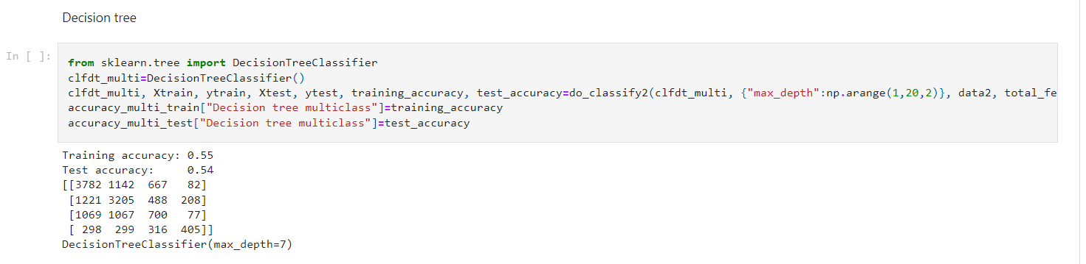
Training Accuracy | Testing Accuracy
55% | 54%

Slide 28
RANDOM FOREST
Random forests combine the predictions of multiple decision trees.
Random forest is a meta estimator that fits a number of decision tree classifiers on various sub-samples of the dataset and uses averaging to improve the predictive accuracy.
Select random samples from a given dataset.
Construct a decision tree for each sample and get a prediction result from each decision tree.
Perform a vote for each predicted result.
Select the prediction result with the most votes as the final prediction.

Slide 29
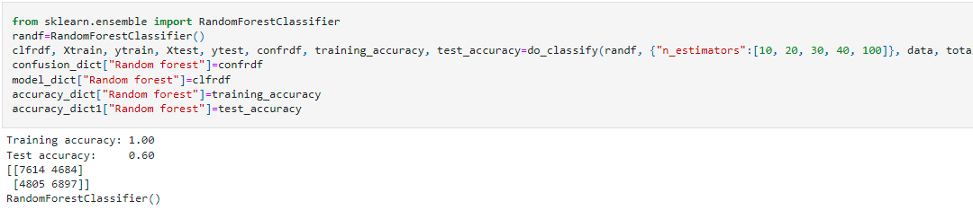
Training Accuracy | Testing Accuracy
100% | 60%

Slide 30
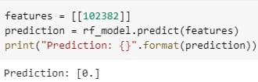
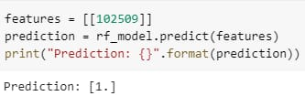
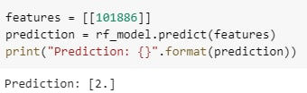
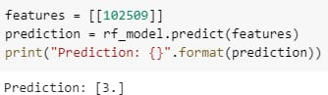
Prediction Of Multi Class Classification
Theft Prediction
Battery Prediction
Criminal damage Prediction
Narcotics Prediction

Slide 31
MULTINOMINAL LOGISTIC REGRESSION
Multinomial logistic regression is an extension of logistic regression for multi-class classification.
Problem transformed into multiple binary classification problems.
The logistic regression() function was used to implement the model, it was then fit into the trained data.
The fit model was then tested on the test set in to check the performance of the developed model.
Logestic regression uses a siogmoid function to predict the output. The sigmoid fuction returns a value from 0 to 1.Take threshold as 0.5
If the sigmoid function returns a value greater than or equal to 0.5, then the output take it as 1 and if the value is less than 0.5,it take it as 0

Slide 32
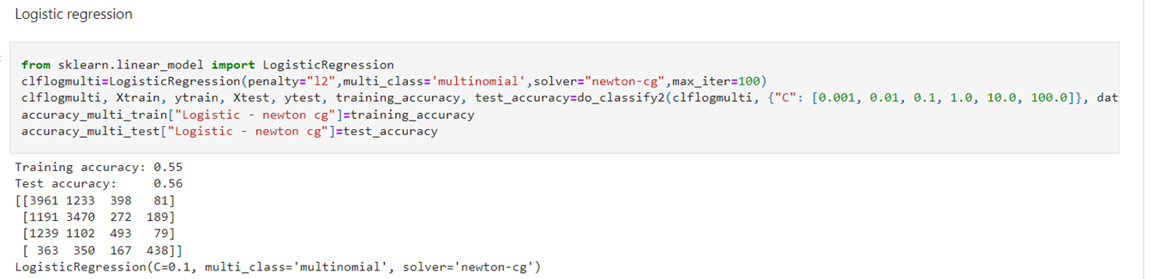
Training Accuracy | Testing Accuracy
55% | 56%

Slide 33
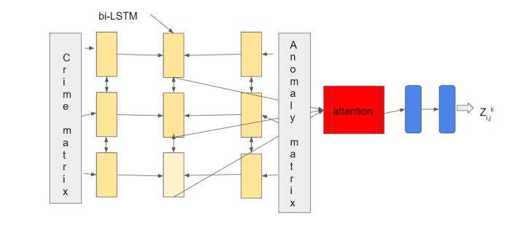
BI-LSTM Architecture
.

Slide 34
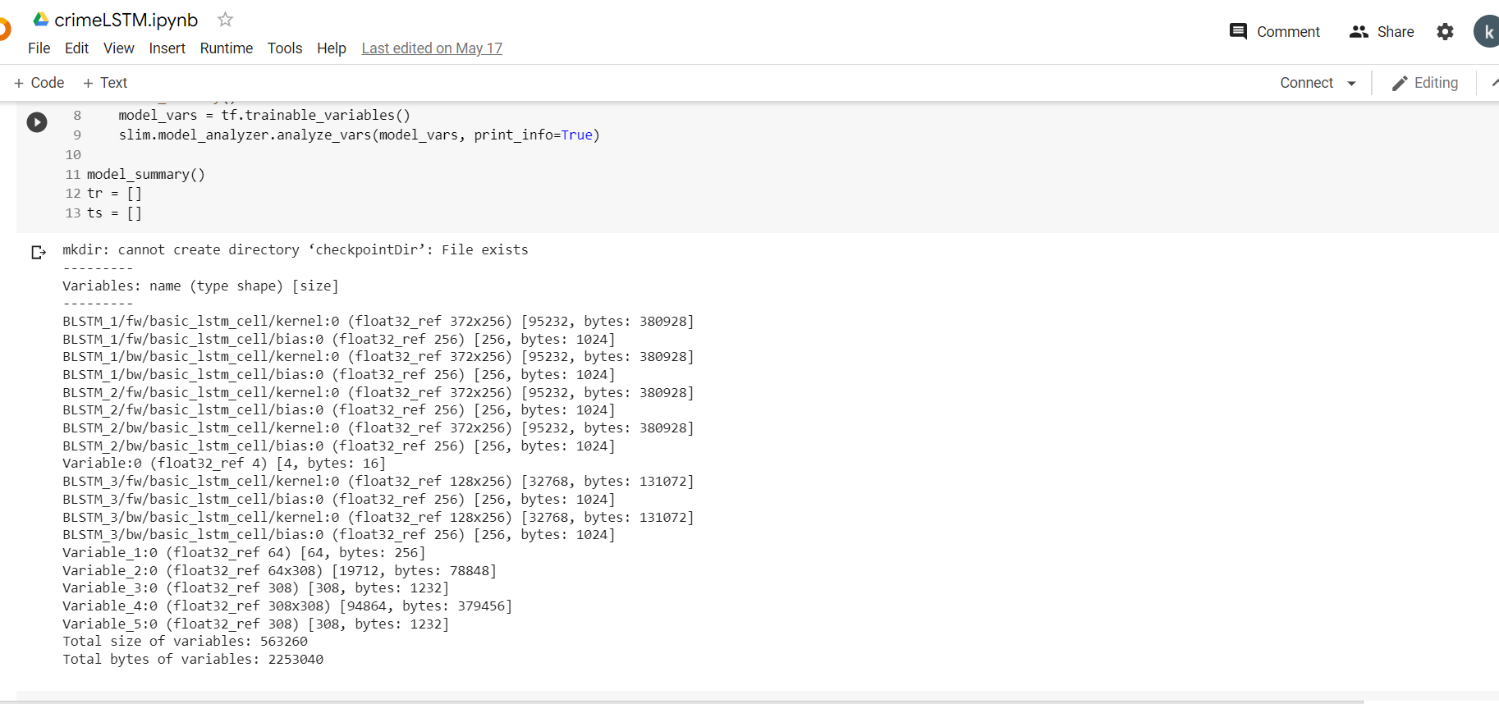
Model summary

Slide 35
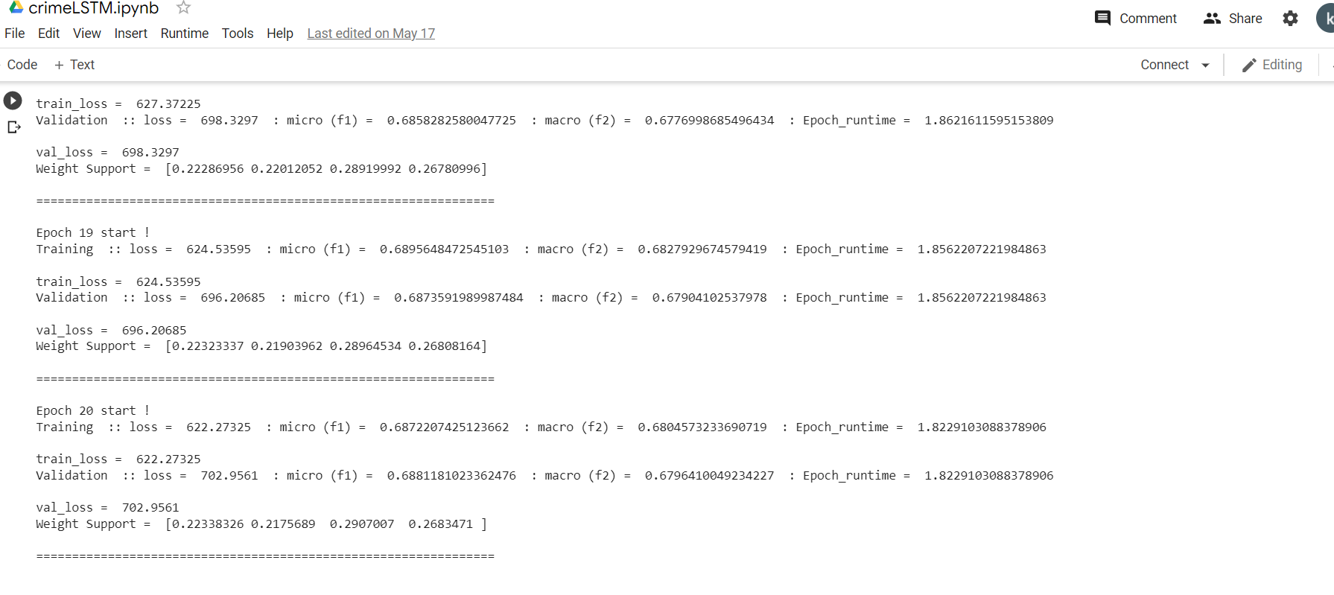
TRAINING AND VALIDATION

Slide 36
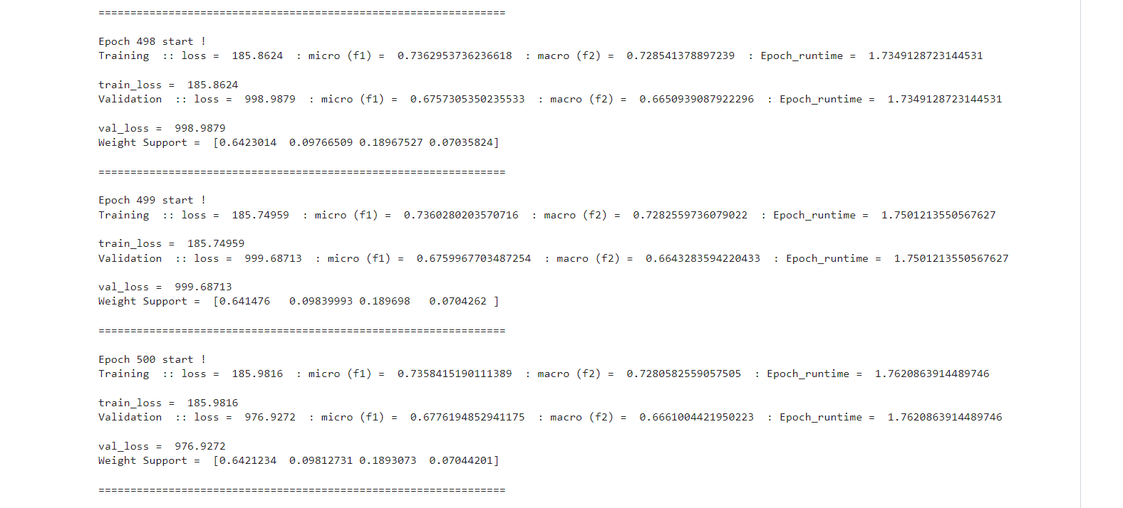
TRAINING AND VALIDATION
BY INCREASING EPOCH

Slide 37
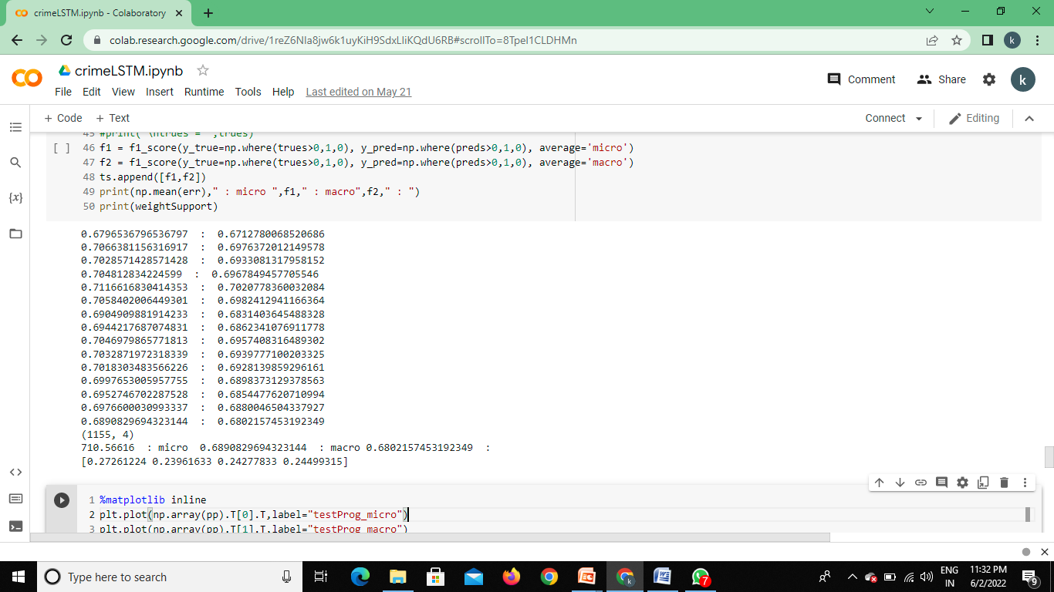
F1 MACRO Vs F1 MICRO

Slide 38
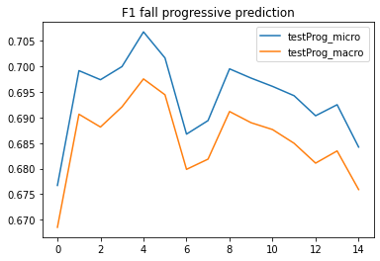
F1 MACRO Vs F1 MICRO

Slide 39
Thank you

